Slide 1

DATA & AI ENGINEER PROJECT
Late Deliveries & What Customers Say
KEERTHIKA N
B.Tech Information Technology(2026 Passout)

Slide 2



PROBLEM
1
What We Want to Understand
•
How many orders were delivered late?
Problem :
•
Which months had more late deliveries?
Late deliveries can make customers unhappy and affect the overall shopping experience.
•
Do late deliveries get lower review scores?
•
What are customers saying in their reviews?
•
Is there a difference between late and on-time orders?
Goal
Understand delivery problems and customer feedback to help the Operations team improve delivery and customer experience.

Slide 3






APPROACH
2
1
2
3
4
5
Data Collection
Data Preparation
Delivery Analysis
AI Review Analysis
Business Insights
Olist Orders
Olist Order Items
Olist Reviews
Clean the data
Combine at order level
Keep delivered orders
Late delivery rate
Monthly late rate
Review scores
Classify 200 reviews
5 fixed themes
Validate 30 reviews
Compare late vs on-time
Identify key problems
Suggest actions
Tools Used
Python
DuckDB
Groq API
Matplotlib
VS Code

Slide 4
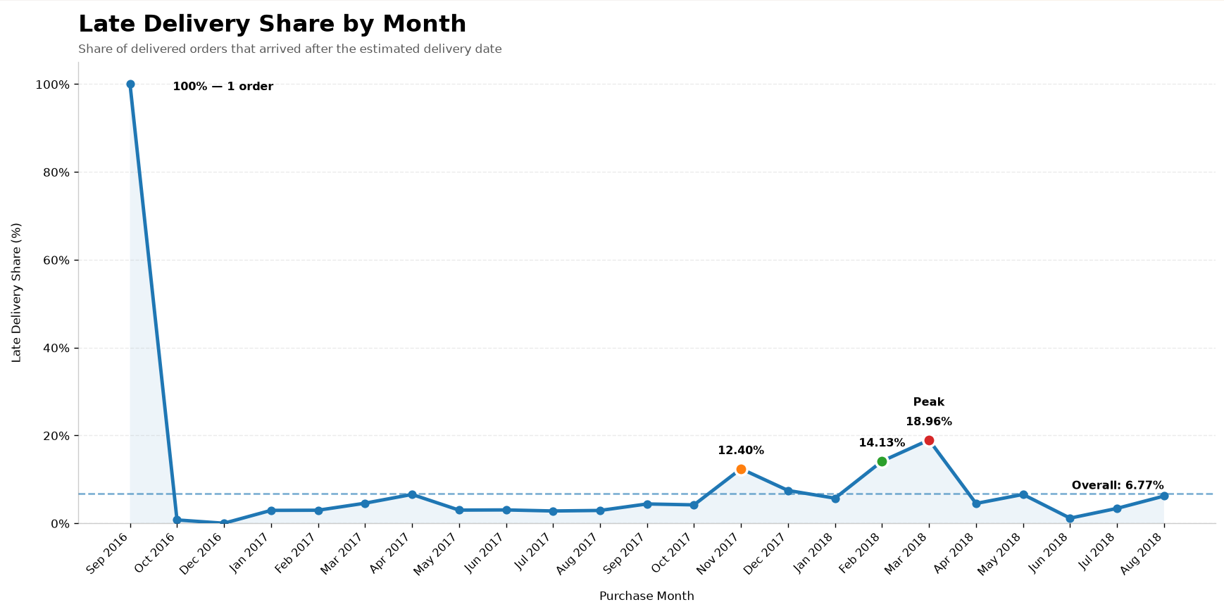
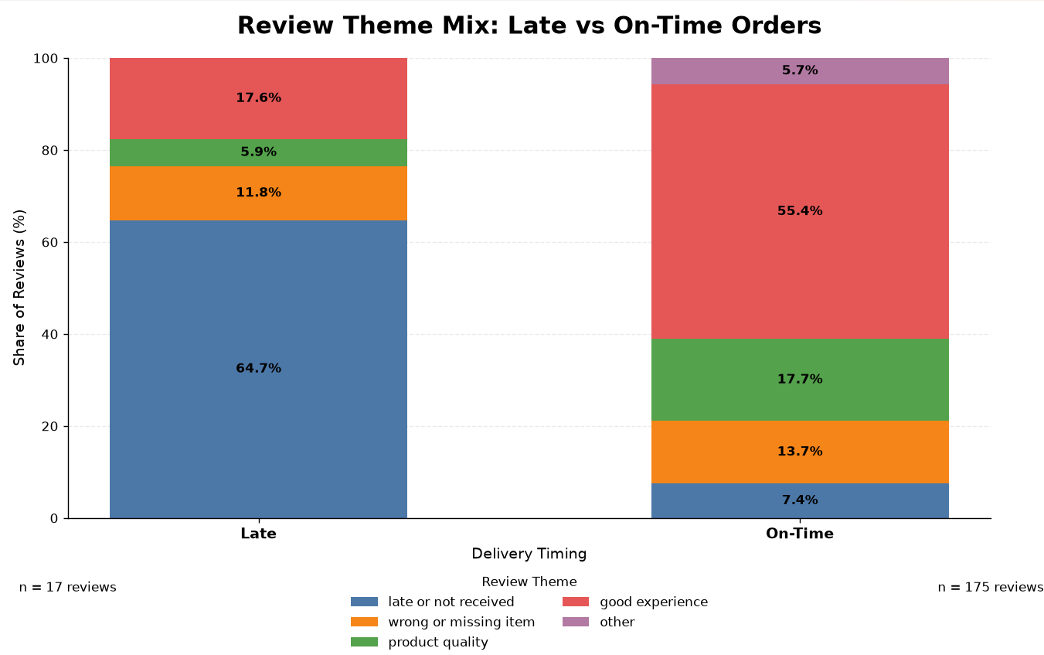
RESULTS
3
96,470
6.77%
2.27 vs 4.29
Delivered Orders
Late Delivery Rate
6,534 late orders
Average Review Score
Late vs On-Time
Optional: Seller-level late-share analysis completed for sellers with 50+ orders.
AI Review Validation 26/30 correct · 86.67%
2,781 orders were more than 7 days late → average review score 1.70
Late: 64.71% late/not received | On-time: 55.43% good experience

Slide 5
RECOMMENDATIONS
4
Top 3 actions for the Head of Operations
01
02
03
Act Early on Delayed Orders
Find & Fix the Causes of Delays
Keep Customers Informed
Find delayed orders early and take action.
Check why delays are happening and fix the problem.
Tell customers when their orders are delayed.
2,781 orders were more than 7 days late.
March 2018 had the highest late rate at 18.96%.
64.71% of late-order reviews mentioned late/not received issues.

Slide 6
WHAT I LEARNED
5
1. Data Quality Is Important
2. Late Delivery Impacts Customer Experience
Data needs to be cleaned and validated before analysis.
Late orders received lower review scores than on-time orders.
3. Customer Reviews Give Useful Insights
4. AI Results Need Validation
The LLM helped classify reviews, but the results still needed manual checking.
26/30 correct — 86.67%
Review comments helped understand the problems faced by customers.
Final Takeaway :
I learned how to turn raw data and customer feedback into useful business insights.

Slide 7
Thank You

